Slide 1
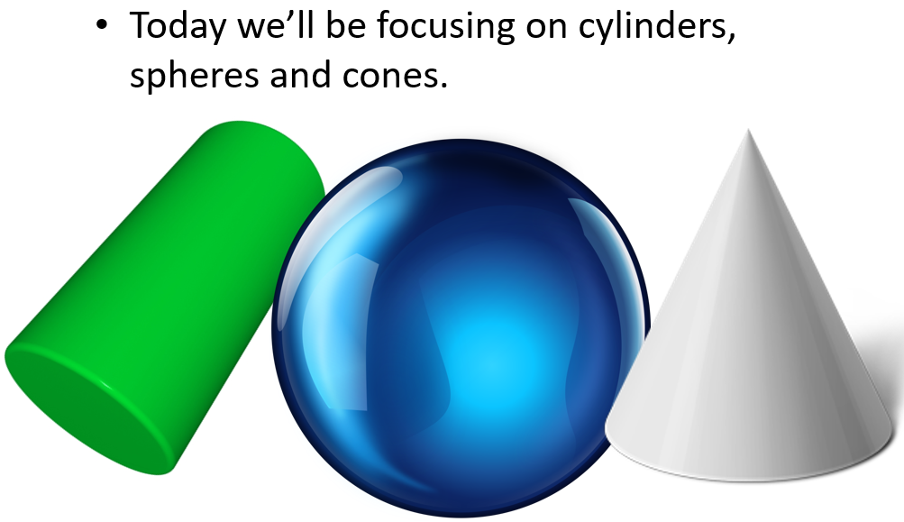
Lesson objective
By the end of this lesson you will be able to
find the surface area of cylinders, spheres and cones.
Notes:
Lesson

Slide 2

24
7
30
Date
Surface Area
EQ – How do I calculate the surface area of cylinders, spheres and cones?
The surface area of a shape is how much space is visible on the outside (if you dunked the shape into a pot of paint, it’s the area that would become coloured).
What is the surface area of a shape?
The surface area of a 3D shape is the area of its 2D net, so let’s see if we can deconstruct some of our shapes.
5
Notes:
Input

Slide 3
Surface Area - Cylinder
Now we know that a cylinder’s net is made up of two circles and a rectangle, but what are the dimensions?
The height of the rectangle is the height of the original cylinder, but what about the width?
For the width, we need to know the circumference of the circular ends.

Slide 4

Surface Area - Cylinder
Using this knowledge, our surface area formula for a cylinder is
$$2πrh+2πr^{2}$$

Slide 5
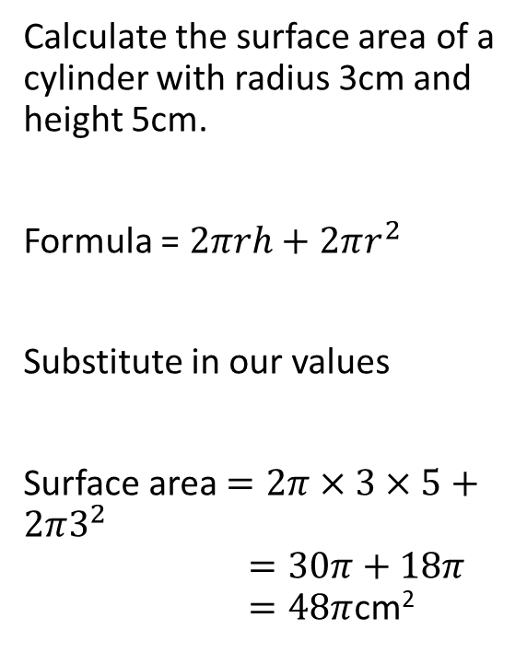
24
7
30
Date
Surface Area
EQ – How do I calculate the surface area of cylinders, spheres and cones?
How do I find the surface area of a cylinder?
Calculate the surface area of a cylinder with radius 3cm and height 5cm.
Formula = $2πrh+2πr^{2}$
Substitute in our values
Surface area $=2π×3×5+2π3^{2}$ $=30π+18π$ $=48π$cm²
5
Notes:
Input

Slide 6
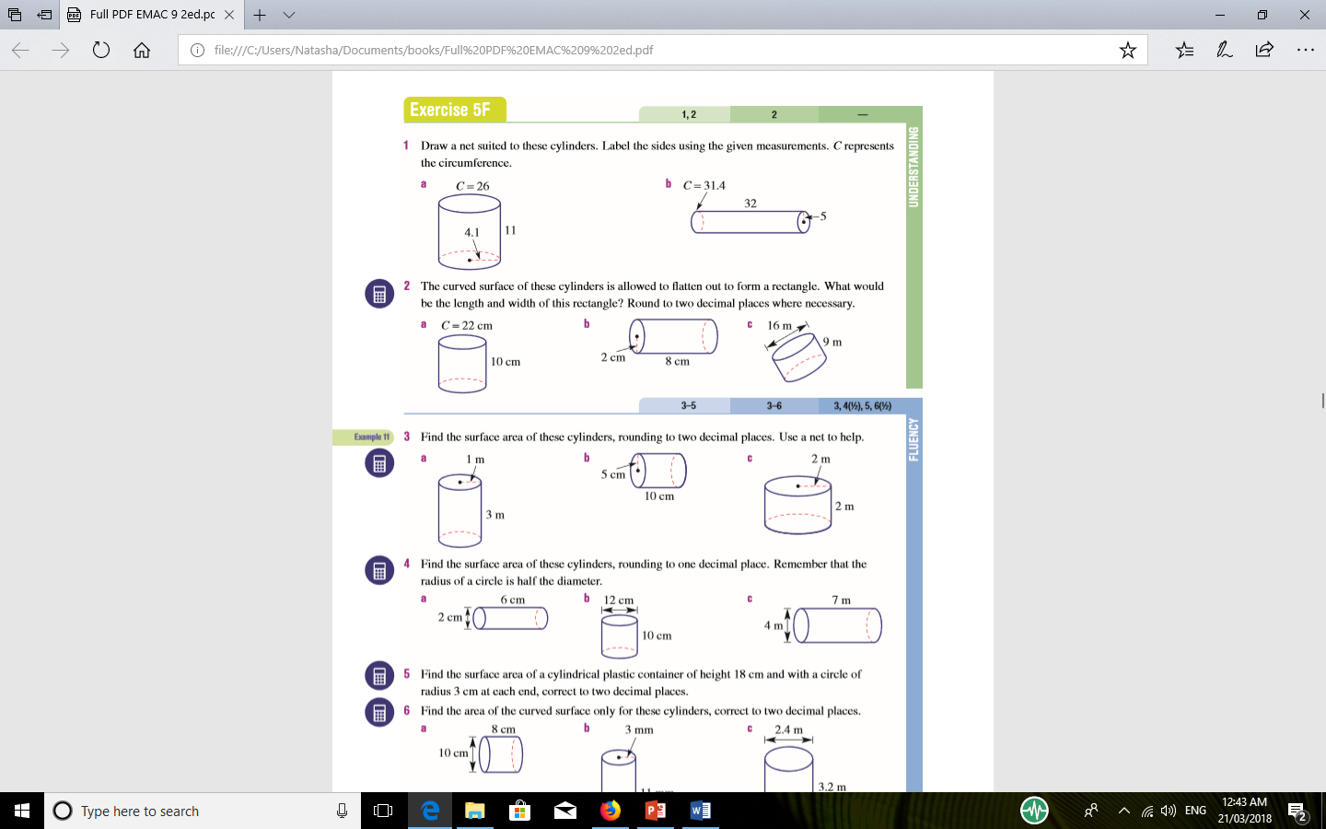

Slide 7

Surface Area - Sphere
Unfortunately, a sphere has no actual 2D net, only close approximations.
Fortunately, we get away with being given the formula again (as proof or derivation is relatively tricky).

Slide 8
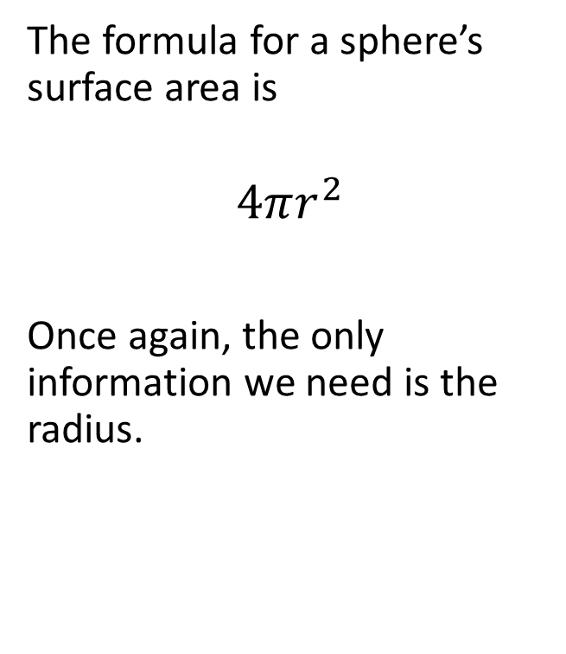
Surface Area - Sphere
The formula for a sphere’s surface area is
$$4πr^{2}$$
Once again, the only information we need is the radius.

Slide 9
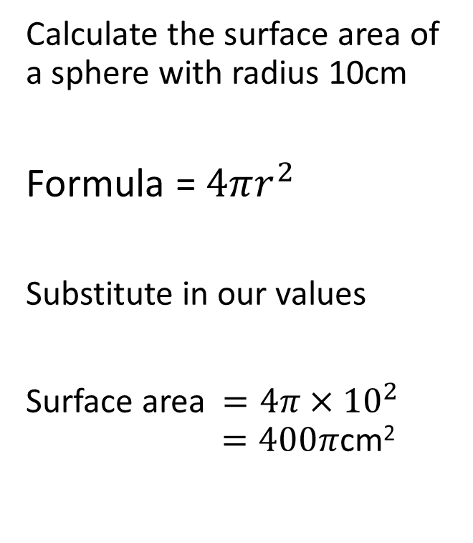
24
7
30
Date
Surface Area
EQ – How do I calculate the surface area of cylinders, spheres and cones?
Calculate the surface area of a sphere with radius 10cm
Formula = $4πr^{2}$
Substitute in our values
Surface area $=4π×{10}^{2}$ $=400π$cm²
How do I find the surface area of a sphere?
5
Notes:
Input

Slide 11
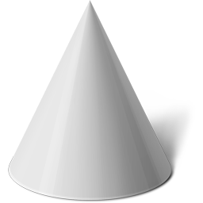
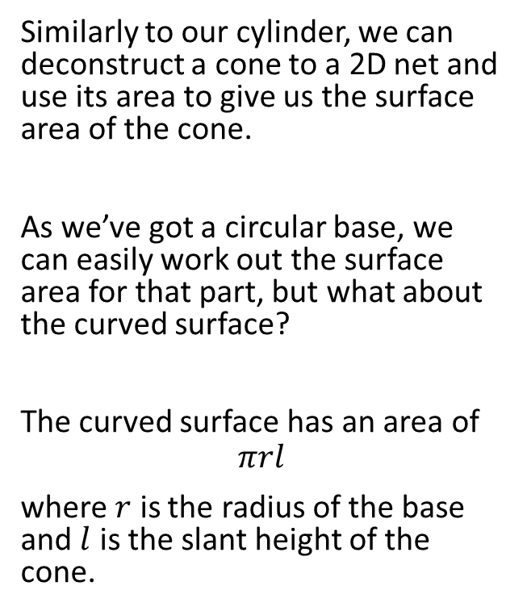

Surface Area - Cone
Similarly to our cylinder, we can deconstruct a cone to a 2D net and use its area to give us the surface area of the cone.
As we’ve got a circular base, we can easily work out the surface area for that part, but what about the curved surface?
The curved surface has an area of
$$πrl$$
where $r$ is the radius of the base and $l$ is the slant height of the cone.
$$l$$

Slide 12

Surface Area - Cone
Using what we’ve now derived, the total surface area of a cone is
$$πrl+ πr^{2}=πr(l+r)$$

Slide 13
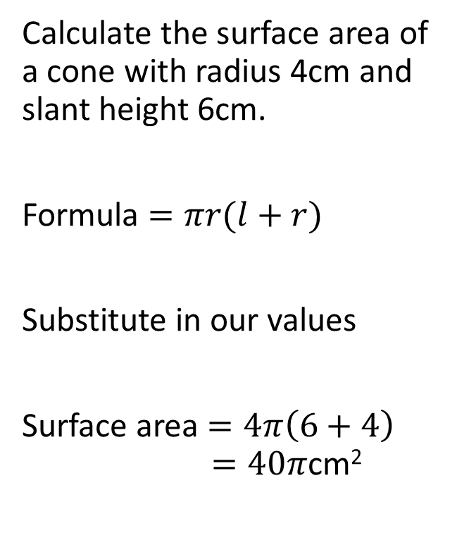
24
7
30
Date
Surface Area
EQ – How do I calculate the surface area of cylinders, spheres and cones?
How do I find the surface area of a cone?
Calculate the surface area of a cone with radius 4cm and slant height 6cm.
Formula $=πr(l+r)$
Substitute in our values
Surface area $=4π\left(6+4\right)$ $=40π$cm²
5
Notes:
Input

Slide 14
Your Turn- Task 1
Grab your white boards or blank pieces of papers and keep your formulae prepared in front of you.
Calculate the surface area for the upcoming shapes (keep π as π in your answers).

Slide 15
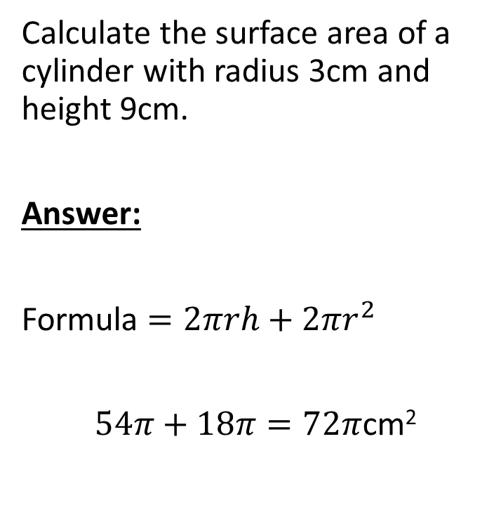
Question 1
Calculate the surface area of a cylinder with radius 3cm and height 9cm.
Answer:
Formula $=2πrh+2πr^{2}$
$54π+18π=72π$cm²

Slide 16
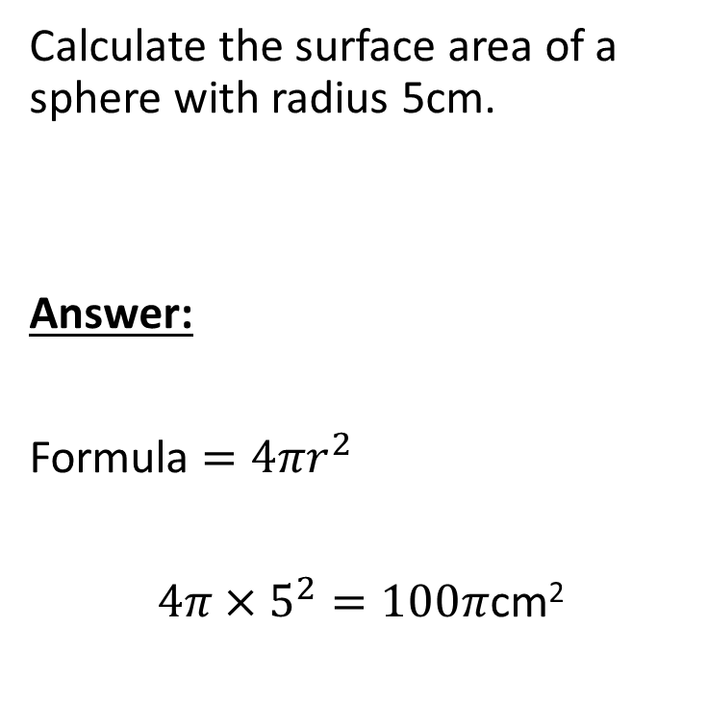
Question 2
Calculate the surface area of a sphere with radius 5cm.
Answer:
Formula $=4πr^{2}$
$4π×5^{2}=100π$cm²

Slide 17
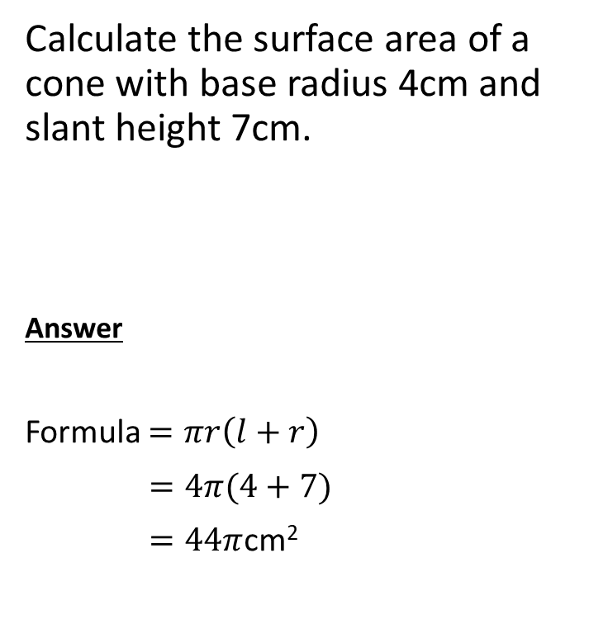
Question 3
Calculate the surface area of a cone with base radius 4cm and slant height 7cm.
Answer
Formula $=πr\left(l+r\right)$
$=4π(4+7)$
$=44π$cm²

Slide 18
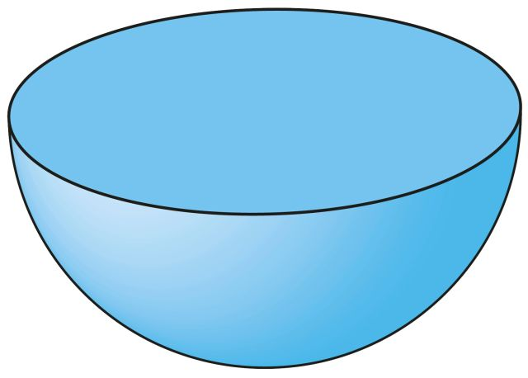
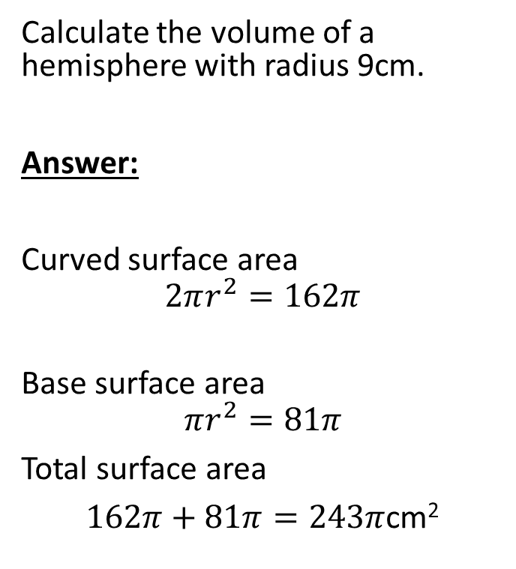
Question 4
Calculate the volume of a hemisphere with radius 9cm.
Answer:
Curved surface area
$$2πr^{2}=162π$$
Base surface area
$$πr^{2}=81π$$
Total surface area
$162π+81π=243π$cm²

Slide 19
Your Turn- Task 2
Work through the exercises p 22-26 Black MAWA Essential Mathematics

